Slide 1
ENGG2013 Unit 5
Linear Combination
& Linear Independence
Jan, 2011.

Slide 2
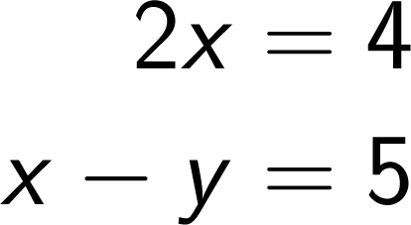
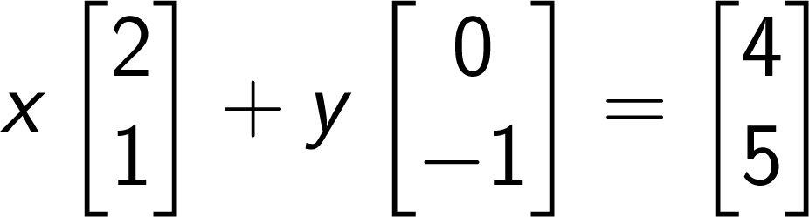

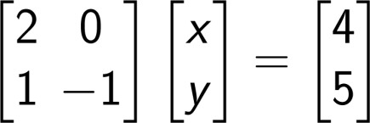

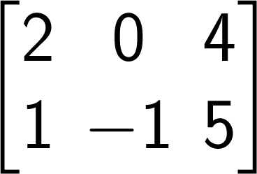

Last time
How to multiply a matrix and a vector
Different ways to write down a system of linear equations
  Vector equation
  Matrix-vector product
  Augmented matrix
Column vectors
kshum
ENGG2013
Notes:
\begin{bmatrix}
2 & 0\\
1 & -1
\end{bmatrix}
\begin{bmatrix}
x\\
y
\end{bmatrix}
=
\begin{bmatrix}
4\\
5
\end{bmatrix}

Slide 3
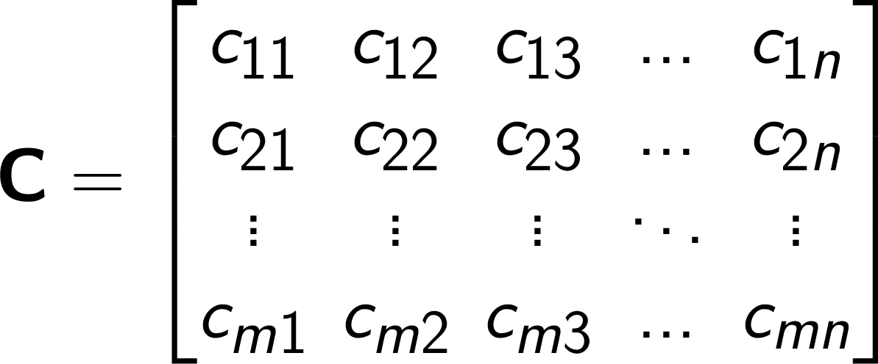
Review: matrix notation
m × n
In ENGG2013, we use capital bold letter for matrix.
The first subscript is the row index, the second subscript is the column index.
The number in the i-th row and the j-th column is called the (i,j)-entry.
  c_{ij} is the (i,j)-entry in C.
kshum
ENGG2013
Notes:
\mathbf{C} =
\begin{bmatrix}
c_{11} & c_{12} & c_{13} & \ldots & c_{1n}\\
c_{21} & c_{22} & c_{23} & \ldots & c_{2n}\\
\vdots & \vdots & \vdots & \ddots & \vdots\\
c_{m1} & c_{m2} & c_{m3} & \ldots & c_{mn}\\
\end{bmatrix}

Slide 4
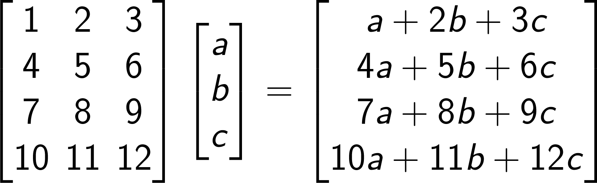
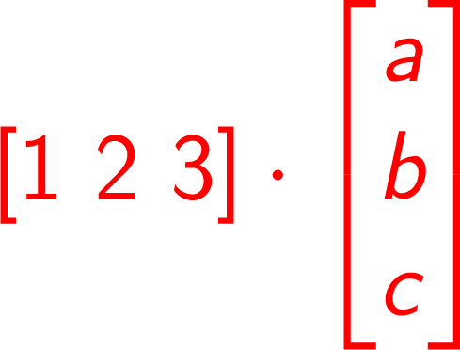
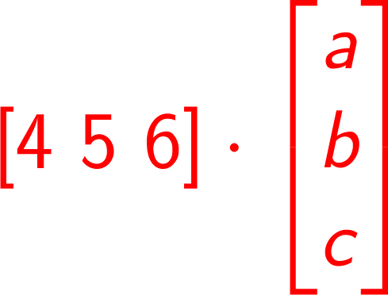
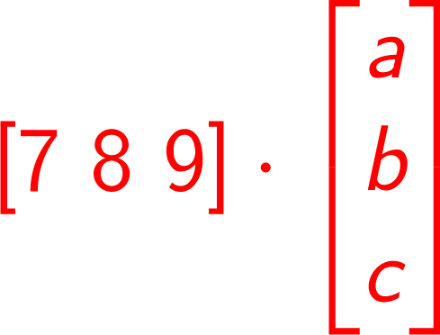
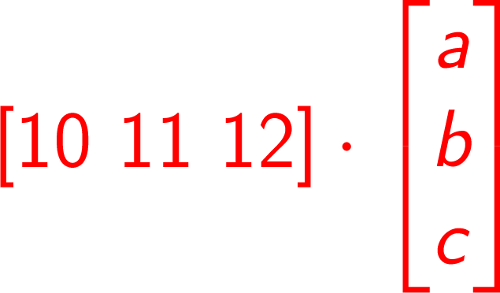
Matrix-vector multiplication
kshum
ENGG2013
Notes:
\begin{bmatrix}
1 & 2 & 3 \\
4 & 5 & 6 \\
7 & 8 & 9 \\
10 & 11 & 12 \\
\end{bmatrix}
\begin{bmatrix}
a\\
b\\
c
\end{bmatrix}
=\begin{bmatrix}
a+2b+3c\\
4a+5b+6c\\
7a+8b+9c\\
10a+11b+12c
\end{bmatrix}

Slide 5
Today
When is A x = b solvable?
  Given A, under what condition does a solution exist for all b?
For example, the nutrition problem: find a combination of food A, B, C and D in order to satisfy the nutrition requirement exactly.
 | Food A | Food B | Food C | Food D | Requirement
Protein | 9 | 8 | 3 | 3 | 5
Carbohydrate | 15 | 11 | 1 | 4 | 5
Vitamin A | 0.02 | 0.003 | 0.01 | 0.006 | 0.01
Vitamin C | 0.01 | 0.01 | 0.005 | 0.05 | 0.01
Can we solve A x = b for fixed A and various b?
Different people have
different requirements
kshum
ENGG2013

Slide 6
Today
Basic concepts in linear algebra
  Linear combination
  Linear independence
  Span
kshum
ENGG2013

Slide 7
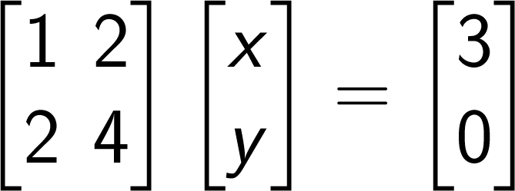
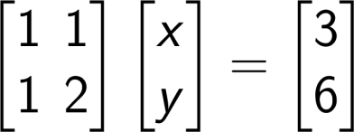
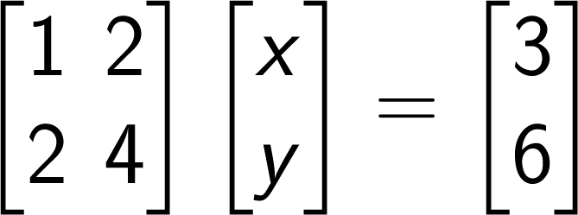
Three cases: 0, 1, ∞
A x = b
How to determine?
m equations
n variables
No solution
Unique solution
Infinitely many
solutions
kshum
ENGG2013

Slide 8
GEOMETRY FOR LINEAR SYSTEM
TWO EQUATIONS
kshum
ENGG2013

Slide 9
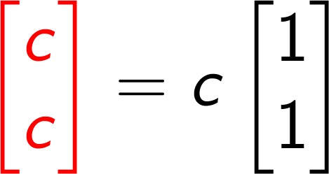

Scaling
c is any real number
y
y
c
1
x
c
1
x
kshum
ENGG2013

Slide 10
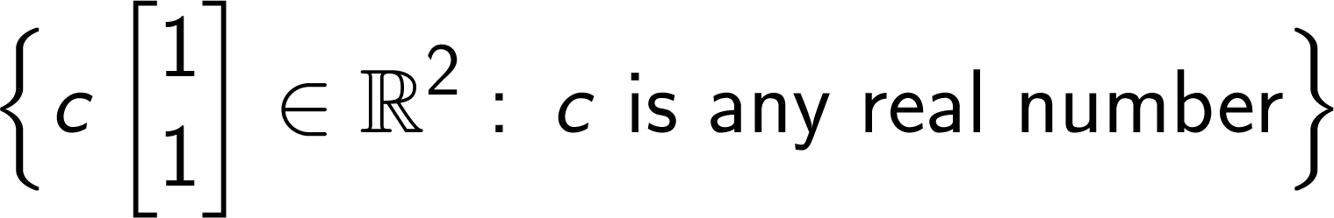
Representing a straight line by vector
Any point on the line y=x can
be written as
y
y
y=x
c
x
c
x
kshum
ENGG2013

Slide 11
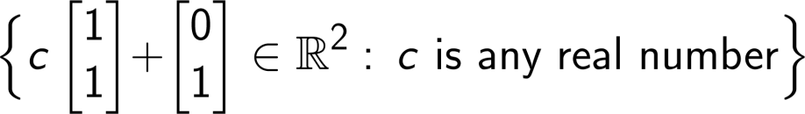

Adding one more vector
y
y
y=x
y=x+1
x
x
kshum
ENGG2013
Notes:
\Big\{ c\begin{bmatrix}
1\\
1
\end{bmatrix} + \begin{bmatrix}
0\\
1
\end{bmatrix}\in \mathbb{R}^2:\, c \text{ is any real number}\Big\}

Slide 12
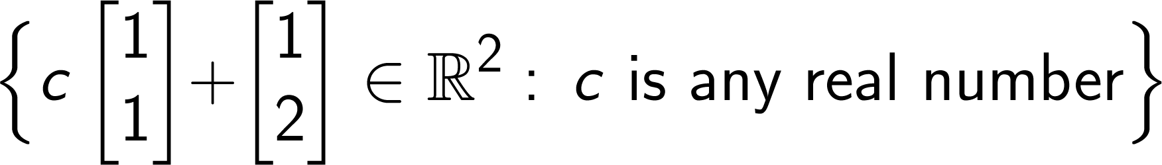

We can add another vector and get the same result
=
y
y
y=x+1
y=x+1
x
x
kshum
ENGG2013
Notes:
\Big\{ c\begin{bmatrix}
1\\
1
\end{bmatrix} + \begin{bmatrix}
0\\
1
\end{bmatrix}\in \mathbb{R}^2:\, c \text{ is any real number}\Big\}

Slide 13
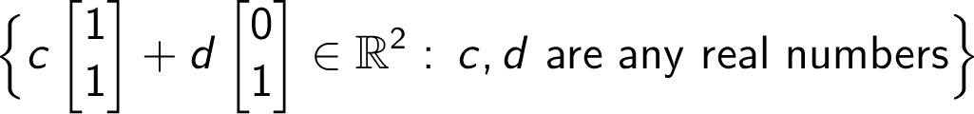

The whole plane
y
x
Scanner
kshum
ENGG2013
Notes:
\Big\{ c\begin{bmatrix}
1\\
1
\end{bmatrix} + \begin{bmatrix}
0\\
1
\end{bmatrix}\in \mathbb{R}^2:\, c \text{ is any real number}\Big\}

Slide 14

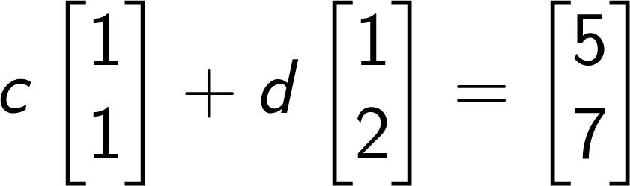
Question 1
7
Can you find c and d such that
?
6
5
4
3
2
1
2
3
4
5
kshum
ENGG2013

Slide 15
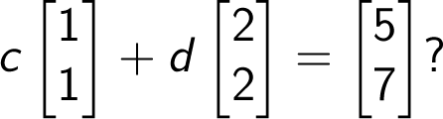
Question 2
7
Can you find c and d such that
6
5
4
3
2
1
2
3
4
5
kshum
ENGG2013

Slide 16
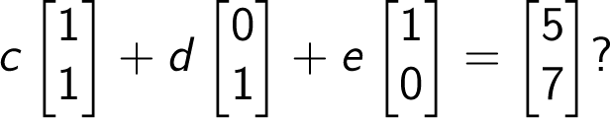
Question 3
7
Can you find c, d, and e such that
6
5
4
3
2
1
2
3
4
5
kshum
ENGG2013

Slide 17
GEOMETRY FOR LINEAR SYSTEM
THREE EQUATIONS
kshum
ENGG2013

Slide 18

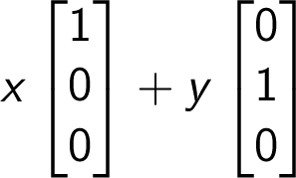
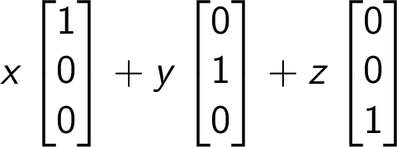

From line to plane to space
z
Any point in the x-y plane
can be written as
y
Any point in the 3-D space
can be written as
z
y
x
Scalar multiples
of
z
x
x
kshum
ENGG2013

Slide 19
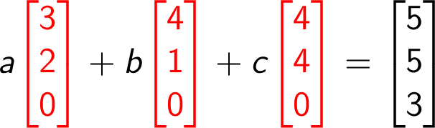
Question 4
Can you find a, b, and c, such that
?
z
y
The three red arrows
all lie in the x-y plane
x
kshum
ENGG2013

Slide 20
Question 5
Can you scale up (or down) the three red arrows
such that the resulting vector sum is equal to the
blue vector?
z
y
The three red arrows
all lie in the shaded plane.
x
kshum
ENGG2013

Slide 21
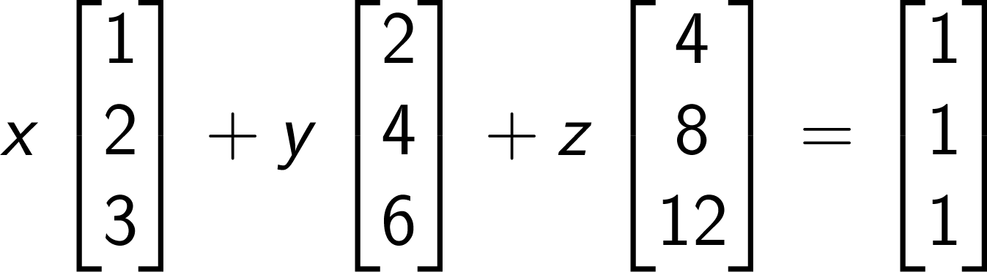
Question 6
Can you find x, y and z such that
?
z
y
The three red arrows
all lie in a straight line.
x
kshum
ENGG2013

Slide 22
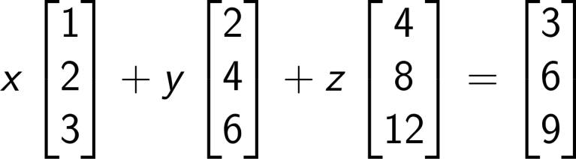
Question 7
Can you find x, y and z such that
?
z
y
The three red arrows
and the blue arrow
are all on the same line.
x
kshum
ENGG2013
Notes:
x
\begin{bmatrix}
1\\
2\\
3
\end{bmatrix}+
y
\begin{bmatrix}
2\\
4\\
6
\end{bmatrix}+
z
\begin{bmatrix}
4\\
8\\
12
\end{bmatrix}=
\begin{bmatrix}
3\\
6\\
9
\end{bmatrix}

Slide 23
ALGEBRA FOR LINEAR EQUATIONS
kshum
ENGG2013

Slide 24
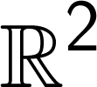

Review on notation
A vector is a list of numbers.
The set of all vectors with two components is called .
is a short-hand notation for saying that
  v is a vector with two components
  The two components in v are real numbers.
kshum
ENGG2013

Slide 25
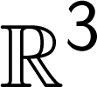

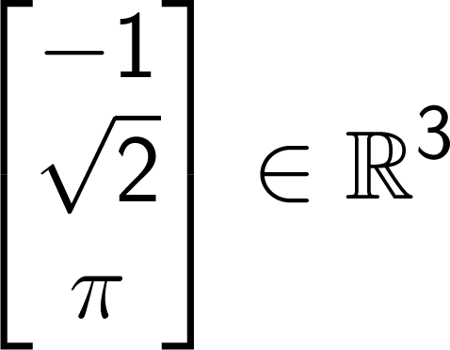
The set of all vectors with three components is called .
is a short-hand notation for saying that
  v is a vector with three components
  The three components in v are real numbers.
kshum
ENGG2013

Slide 26

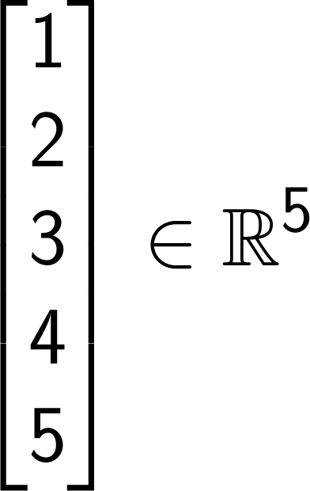
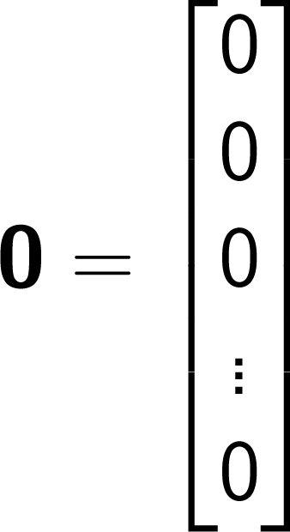
The set of all vectors with n components is called .
We use a zero in boldface, 0, to represent the all-zero vector
kshum
ENGG2013

Slide 27
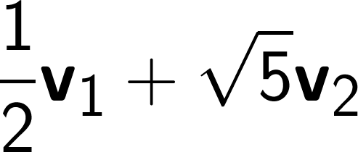


Definition: Linear Combination
Given vectors v₁, v₂, …, v_{i} in , and i real number c₁, c₂, …, c_{i}, the vector w obtained by
w = c₁ v₁+ c₂ v₂+ …+ c_{i} v_{i}
is called a linear combination of v₁, v₂, …, v_{i} .
Examples of linear combination of v₁ and v₂:
kshum
ENGG2013

Slide 28
Picture
Linear combinations of two vectors u and v.
u–2v
3u
2u+0.5v
–v
u
2u+2v
0
v
kshum
ENGG2013

Slide 29
Definition: Span
Given r vectors v₁, v₂, …, v_{r}, the set of all linear combinations of v₁, v₂, …, v_{r} called the span of v₁, v₂, …, v_{r},
We use the notation span(v₁, v₂, …, v_{r}) for the span of span of v₁, v₂, …, v_{r}.
We also say that span(v₁, v₂, …, v_{r}) is spanned by, or generated by v₁, v₂, …, v_{r} .
span(v₁, v₂, …, v_{r}) is the collections of all vectors which can be written as c₁v₁ + c₂v₂ + … + c₂v_{r} for some scalars c₁, c₂, …, c_{r}.
kshum
ENGG2013

Slide 30
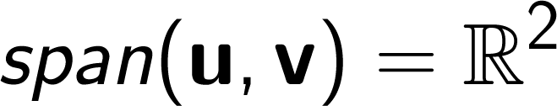
Span of u and v
Linear combinations of this two vectors u and v form the whole plane
u–2v
3u
–v
u
2u+2v
0
v
kshum
ENGG2013

Slide 31

Span of a single vector u
z
y
u
consists of the
points on a straight line
which passes through the origin.
x
kshum
ENGG2013

Slide 32
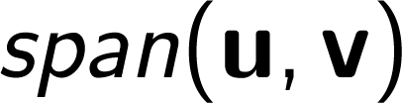
Span of two vectors in 3D
z
y
u
is a plane
through the origin.
v
x
kshum
ENGG2013

Slide 33

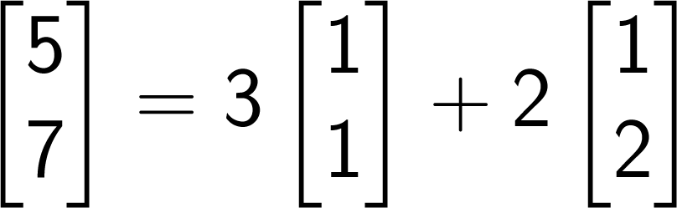
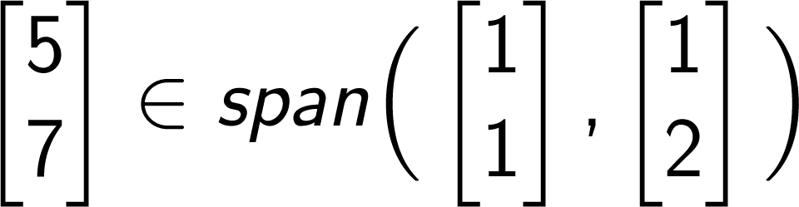
Example
7
is a linear combination of
6
and , because
5
4
3
We therefore say that
2
1
2
3
4
5
kshum
ENGG2013

Slide 34

Mathematical language
Ordinary language
Mathematical language
Let C be the set of all Chinese people.
President Obama is not a Chinese.
President Obama
kshum
ENGG2013

Slide 35
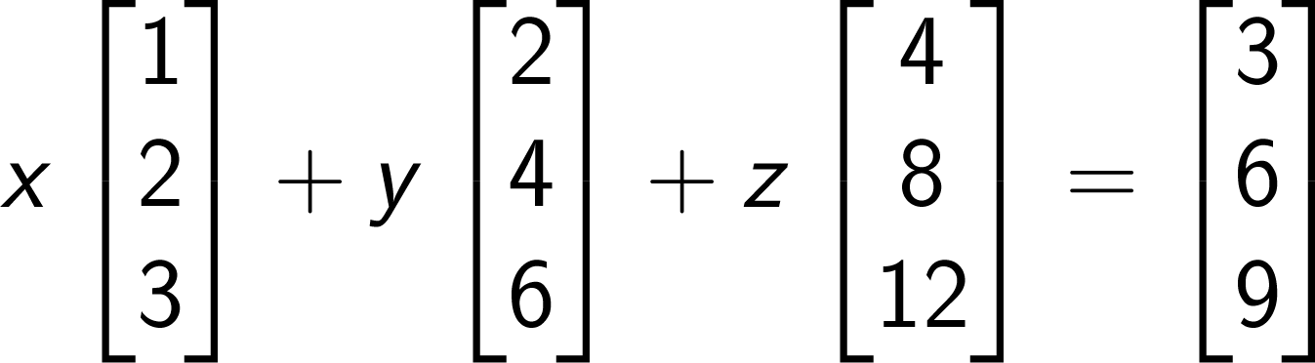
Example
z
y
x
kshum
ENGG2013
Notes:
x
\begin{bmatrix}
1\\
2\\
3
\end{bmatrix}+
y
\begin{bmatrix}
2\\
4\\
6
\end{bmatrix}+
z
\begin{bmatrix}
4\\
8\\
12
\end{bmatrix}=
\begin{bmatrix}
3\\
6\\
9
\end{bmatrix}

Slide 36
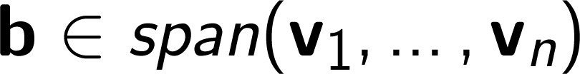
A fundamental fact
“Logically equivalent” means
if one of them is true, then all of them is true
if one of them is false, then all of them is false.
Let
  A be an m×n matrix
  b be an m×1 vector
Let the columns of A be v₁, v₂,…, v_{n}.
The followings are logically equivalent:
1
We can find a vector x such that
2
3
kshum
ENGG2013

Slide 37

Theorem 1
With notation as in previous slide, if the span of be v₁, v₂,…, v_{n} contains all vectors in
then the linear system Ax = b has at least one solution.
In other words, if every vector in can be written as a linear combination of v₁, v₂,…, v_{n}, then Ax = b is solvable for any choice of b.
“Solvable” means there is one
solution or more than one solutions.
kshum
ENGG2013

Slide 38
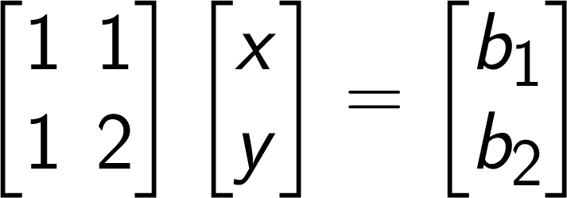
Example
7
Since and span
the whole plane, the linear
system
is solvable for any b₁ and b₂.
6
5
4
3
2
1
2
3
4
5
kshum
ENGG2013

Slide 39
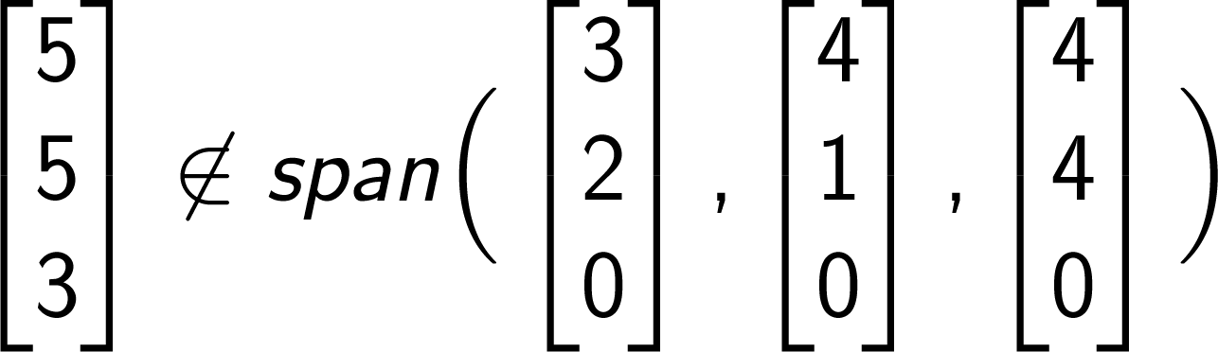
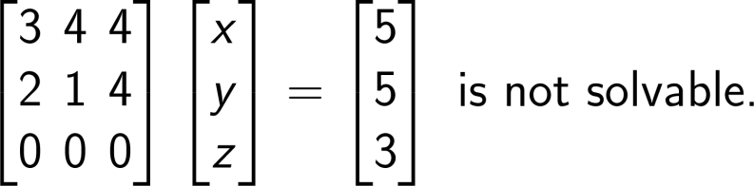
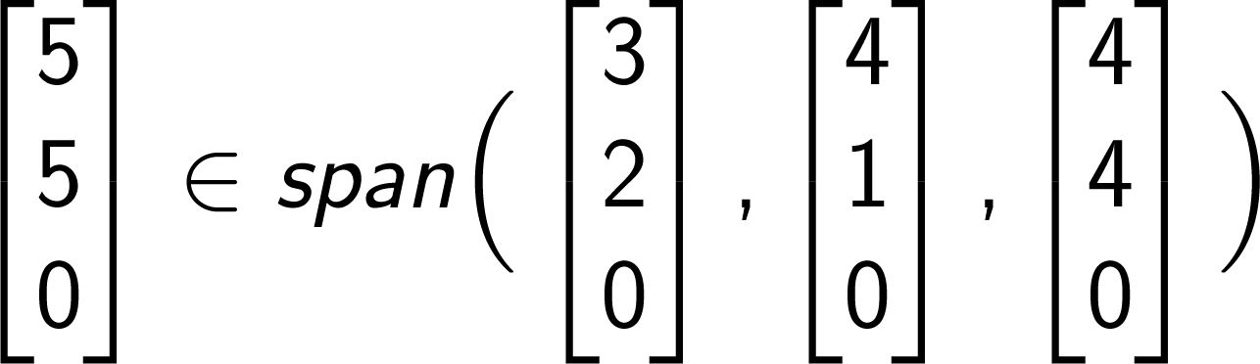
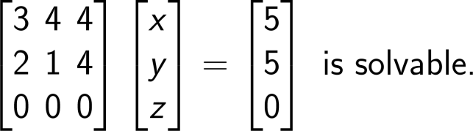
Example
The three red arrows
all lie in the x-y plane
z
y
z
x
y
x
(Infinitely many solutions)
kshum
ENGG2013

Slide 40

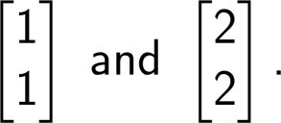
Example
7
6
5
because is not a
linear combination of
4
3
2
1
2
3
4
5
kshum
ENGG2013
Notes:
\begin{bmatrix}
1 & 2 \\
1 & 2 \end{bmatrix}
\begin{bmatrix}
x\\
y
\end{bmatrix}=
\begin{bmatrix}
5\\
7\end{bmatrix} \text{ is not solvable.}

Slide 41
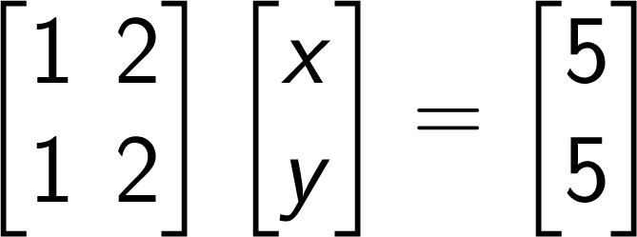

Example
7
6
has infinitely many solutions.
5
4
3
2
1
2
3
4
5
kshum
ENGG2013
Notes:
\begin{bmatrix}
1 & 2 \\
1 & 2 \end{bmatrix}
\begin{bmatrix}
x\\
y
\end{bmatrix}=
\begin{bmatrix}
5\\
7\end{bmatrix} \text{ is not solvable.}

Slide 42




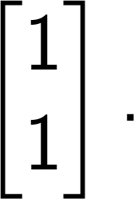
Infinitely many solutions
There is one common feature in
the examples with infinitely many solutions
z
y
y
x
x
Notice that is a scalar
multiple of
is a linear combination of and
The common feature is that one of the vector
is a linear combination of the others.
kshum
ENGG2013
Notes:
\begin{bmatrix}
1 & 2 \\
1 & 2 \end{bmatrix}
\begin{bmatrix}
x\\
y
\end{bmatrix}=
\begin{bmatrix}
5\\
7\end{bmatrix} \text{ is not solvable.}

Slide 43
Definition: Linear dependence
Vectors v₁, v₂, …, v_{r} are said to be linear dependent if we can find r real number c₁, c₂, …, c_{r}, not all of them equal to zero, such that
0 = c₁ v₁+ c₂ v₂+ …+ c_{r} v_{r}
Otherwise, are v₁, v₂, …, v_{r} are said to be linear independent.
In other words, v₁, v₂, …, v_{r} are be linear independent if, the only choice of c₁, c₂, …, c_{r}, such that
0 = c₁ v₁+ c₂ v₂+ …+ c_{r} v_{r}
is c₁ = c₂ = …= c_{r}=0.
kshum
ENGG2013

Slide 44



Example of linear independent vectors
kshum
ENGG2013

Slide 45

Example of linear dependent vectors
kshum
ENGG2013

Slide 46
Example of linear independent vectors
kshum
ENGG2013

Slide 47
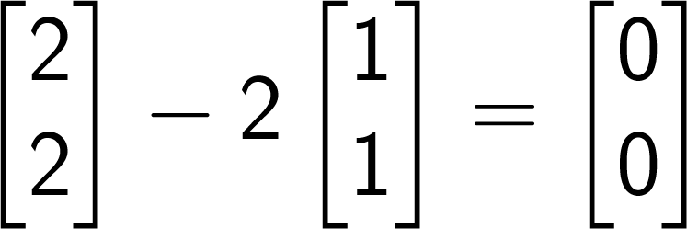
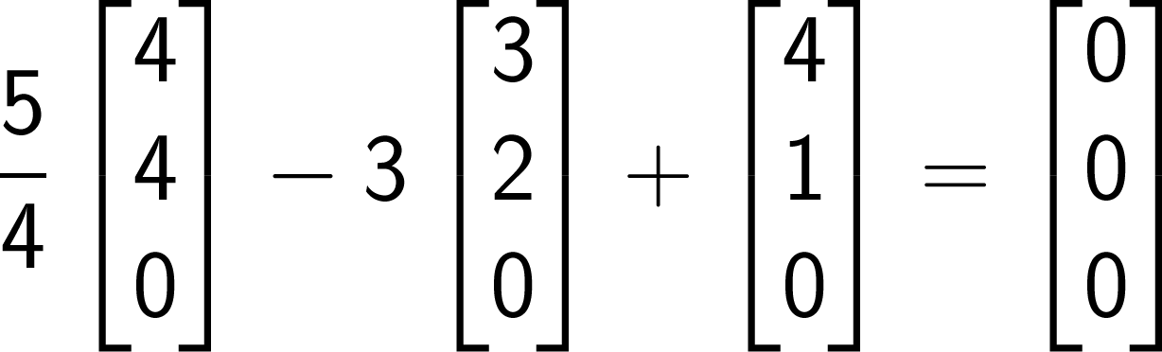
Example
and are linear dependent, because
, and are linear dependent because
kshum
ENGG2013
Notes:
\frac{5}{4}\begin{bmatrix}
4\\
4 \\0
\end{bmatrix}-3\begin{bmatrix}3 \\ 2\\0\\ \end{bmatrix}
+\begin{bmatrix}
4\\
1\\
0
\end{bmatrix} = \begin{bmatrix}
0\\
0 \\ 0
\end{bmatrix}

Slide 48
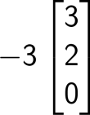


Picture
z
y
x
The three vectors lie on
the same plane, namely,
the x-y plane.
kshum
ENGG2013

Slide 49
Theorem 2
Let
  A be an m×n matrix
  b be an m×1 vector
Let the columns of A be v₁, v₂,…, v_{n}.
Theorem: If v₁, v₂,…, v_{n}, are linear independent, then Ax = b has at most one solution.
kshum
ENGG2013

Slide 50
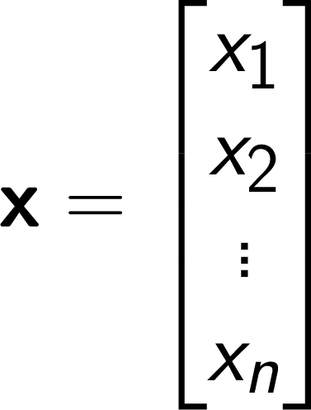


Proof (by contradiction)
Suppose that and are two different solutions to Ax=b,
i.e.,
Therefore
Move every term to the left
But v₁, v₂,…, v_{n} are linear independent by assumption. So, the only
choice is
This contradicts the fact that vector x and vector x’ are different.
kshum
ENGG2013

Slide 51



Example
and are linearly independent.
has a unique solution for
any choice of b₁ and b₂.
In fact, x must equal b₁,
and y must equal b₂/3
in this example.
kshum
ENGG2013

Slide 52



Example
z
is solvable
by Theorem 1, because the blue
vector lies on the plane
spanned by the two red vectors.
The solution is unique
because and are linearly independent.
y
x
kshum
ENGG2013

Slide 53
Summary
The columns of A
contain a lot of information
about the nature of the
solutions.
Ax=b
m equations
n variables
Unique solution
At most one solution
At least one solution
Columns of A are
linearly independent
Every vector in
is a linear combination
of the columns in A.
kshum
ENGG2013

Slide 54



A kind of mirror symmetry
If the columns of A are linear independent, then I am pretty sure that there is one or no solution to Ax=b,
no matter what b is.
If any vector in
can be written as a linear combination of the column vectors in A, then Ax=b must have one or more than one solutions.
kshum
ENGG2013

Slide 55
Basis
A set of vector in which are simultaneously
  linearly independent, and
  spanning the whole space
is of particular importance, and is called a set of basis vectors.
(We will talk about basis in more detail later.)
kshum
ENGG2013

